Slide 1
Computer Vision – Module 1
Dr. Sreejith Rajan 28-1-2026

Slide 2
Course Objectives
To understand the fundamentals of image processing
To familiarise with image enhancement and image segmentation algorithms
To familiarise with computer vision concepts
Comprehensive understanding of feature extraction and image matching techniques.

Slide 3
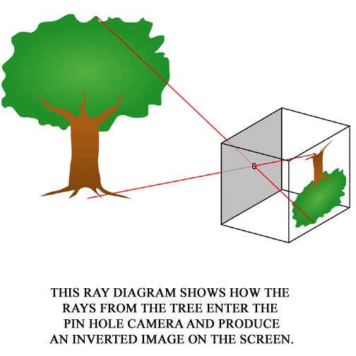
Pinhole Camera
A pinhole camera is a simple optical device that uses a tiny aperture to project an inverted image of an external scene onto a surface inside a light-tight box.
It works on the principle of rectilinear motion of light.
Image will be real, inverted and diminished
Role of Pinhole size on image?
  Small pinhole
  Large pinhole

Slide 4
Characteristics of Pinhole Camera
No lens required
Infinite depth of field
No focusing mechanism
Very low light efficiency
Simple construction

Slide 5
Advantages of Pinhole Camera
No lens aberrations
Very large depth of field
Easy to understand and build
Used as a basic imaging model

Slide 6
Limitations of Pinhole Camera
Low brightness
Poor resolution compared to a lens-based camera
Not suitable for low light conditions

Slide 7
Fundamentals of Gaussian Optics
Gaussian optics is based on the principles of ray optics.
A point source of light emits light rays in all directions.
Light rays propagate in straight lines in a homogeneous medium.
Light rays from a distant source are considered parallel.
Spherical lenses and spherical mirrors obey Gaussian optics when only paraxial rays are considered.
For rays close to the principal axis, the small-angle approximation is valid, leading to simple image-formation equations.

Slide 8
Paraxial Approximation
The paraxial approximation assumes that light rays make small angles with the principal (optical) axis.
Under this condition:
  sin⁡𝜃≈tan⁡𝜃≈𝜃(𝜃 in radians)
This approximation simplifies the geometry of light propagation and leads to linear image-formation equations.
The paraxial approximation is the foundation of Gaussian optics and is valid only for rays close to the optical axis.

Slide 9
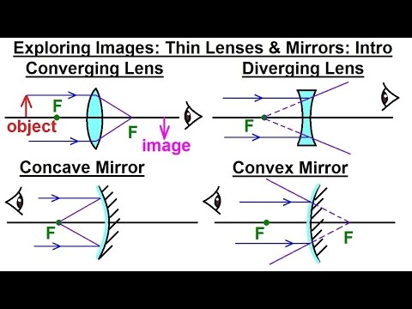
Image Formation in Spherical Mirrors/Lenses

